Slide 1
Routing lists in Alma
Yoel Kortick
Yoel.Kortick@clarivate.com

Slide 2
Agenda
  What is a Routing List?
  A POL which is designated as "Routing during receiving"
  The “Interested Users”
  Receiving and routing the item

Slide 3
What is a Routing List?

Slide 4
What is a Routing List?
It is often the case that serial issues need to be “routed” to various users, in a specific order, when they are received. In this context, "routing" refers to the process of directing each issue to a designated recipient or group in a predetermined sequence — for example, sending a new journal issue first to a faculty member who requested it, then to a reading room, and finally to the stacks for permanent shelving.
While this may also be the case for monographs or other “one-time” type orders, it is more typical for serial issues.
When a serial issue needs to be routed to various users when it is received, the POL should have the checkbox “Routing during Receiving” checked. The “Routing during Receiving checkbox” is in the “Receiving Information” section of the POL

Slide 5
What is a Routing List?
The “Routing during Receiving checkbox” indicates that when an item is received for the POL (selecting Actions > Receive) then a message will display indicating that the order is marked for routing.
Typically, after being informed that the order is marked for routing the receiving operator will print the interested users list.
To print a list of interested users (for PO lines that are Marked for Routing), select “Actions > Print Interested Users List” for the relevant PO line

Slide 6
A POL which is designated as "Routing during receiving"

Slide 7
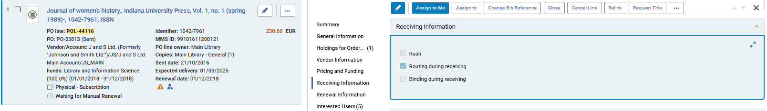
A POL which is designated as "Routing during receiving"
This is POL-44116 for serial title “Journal of women's history”. It contains an indication “Routing during receiving”

Slide 8
The “Interested Users"

Slide 9
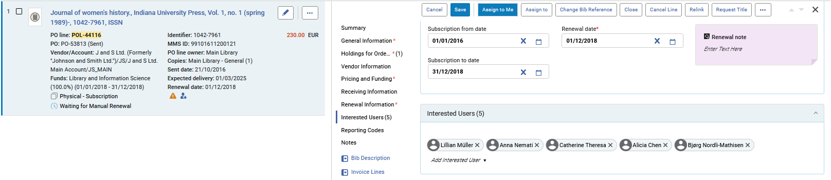
The “Interested Users"
There are 5 interested users

Slide 10
Receiving and routing the item

Slide 11
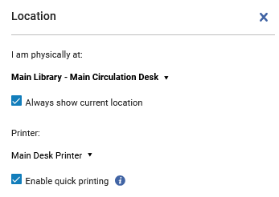
Receiving and routing the item
We will now do “Actions > Receive” from the receiving workbench for POL-44116 title “Journal of women's history”.
Note that we have chosen a printer and enabled quick printing.

Slide 12
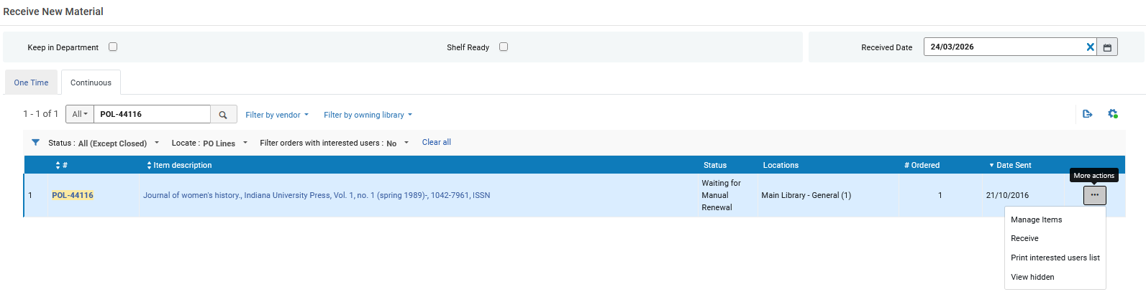
Receiving and routing the item
We receive the item

Slide 13
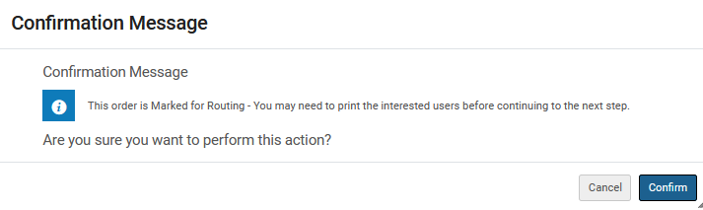
Receiving and routing the item
After clicking “Receive” the staff user gets a message “This order is Marked for Routing – You may need to print the interested users before continuing to the next step”
This message appears because the POL (as we saw) is marked as “Routing during receiving”
We will click “Confirm” and receive the item and then print the list of users

Slide 14
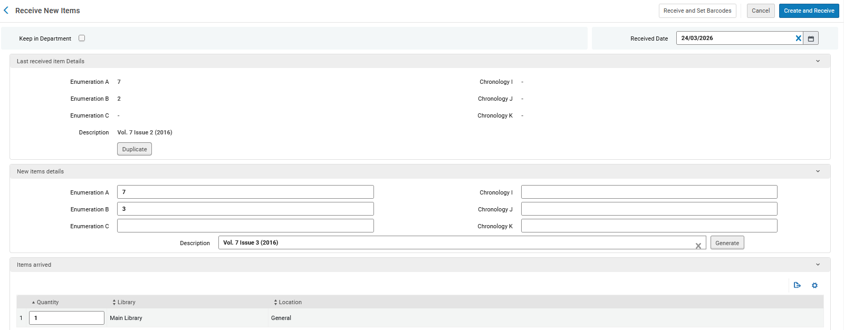
Receiving and routing the item
Receive the item

Slide 15
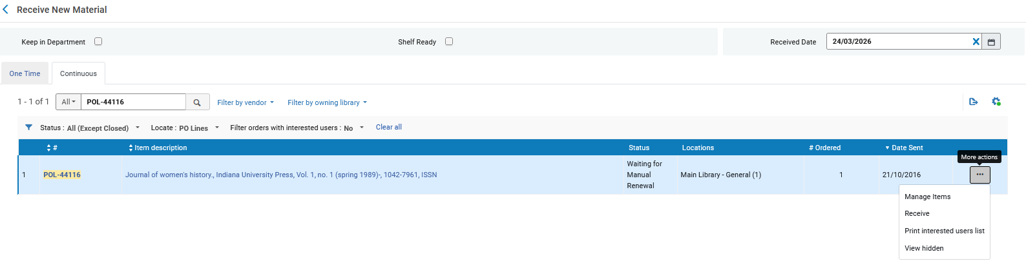
Receiving and routing the item
Print the routing list (interested users list)

Slide 16
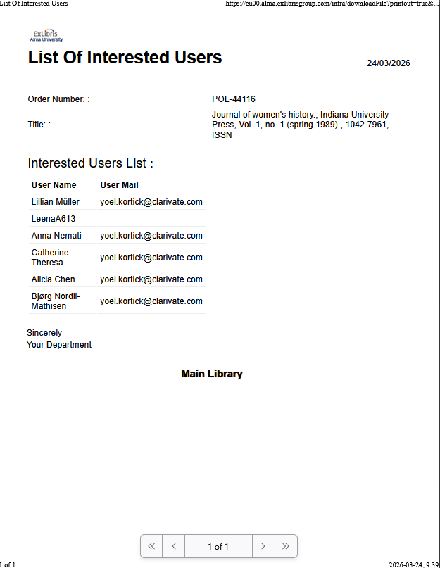
Receiving and routing the item
The list is printed and typically inserted in the serial issue as it goes from user to user

Slide 17


Yoel Kortick
Yoel.Kortick@clarivate.com
About Clarivate
Clarivate is a leading global provider of transformative intelligence. We offer enriched data,
insights & analytics, workflow solutions and expert services in the areas of Academia & Government, Intellectual Property and Life Sciences & Healthcare. For more information, please visit clarivate.com.
© 2026 Clarivate. All rights reserved
Clarivate and its logo, as well as all other trademarks used herein are trademarks of their respective owners and used under license.

